Slide 1
Nonsinusoidal Waveforms

Slide 2
Objective of Lecture
Introduce several nonsinusoidal waveforms including
Impulse function
Step function
Ramp function
Convolutions
Pulse and square waveforms
Sawtooth and triangular waveforms
Discuss how to obtain a mathematical equation to describe a convoluted waveform.
Explain what a composite wavefunction is and define fundamental and harmonic frequencies.

Slide 3
Nonsinusoidal Waveforms
Not all signals in electrical and computer engineering are sinusoidal.
Most digital systems use square waveforms. Although at high switching speeds, these waveforms are starting to look trapezoidal.
Most bioelectric signals are nonsinusoidal, many are composite ramp functions.
When a switch is opened or closed, the time required for the signals to return to steady state is accompanied by sinusoidal and nonsinusoidal transients.

Slide 4
Singularity Functions
Are discontinuous or have discontinuous derivatives.
Also known as switching functions. They are:
Impulse function
Unit function
Ramp functions
Combinations of these functions can be used to describe complex waveforms.
Pulse function
Square waveform
Triangular waveform
Sawtooth waveform

Slide 5
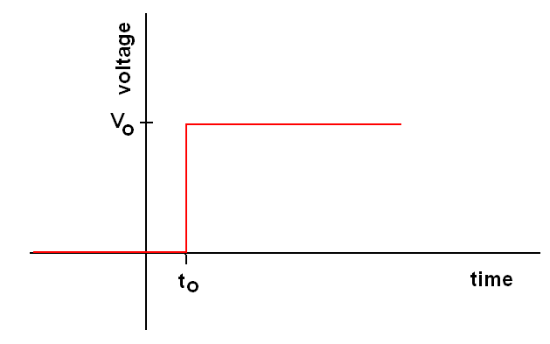
Unit Step Function

Slide 6
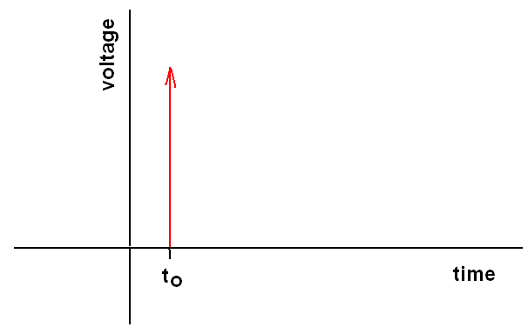
Unit Impulse Function
An impulse function is the derivative of a unit step function.

Slide 7
Unit Ramp Function
A unit ramp function is the result of the integration of a unit step function.

Slide 8
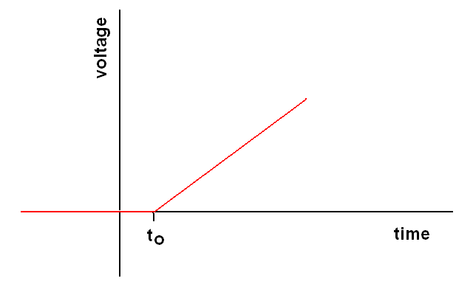
Unit Ramp Function
r(t-t_{o})
Slope = 1

Slide 9
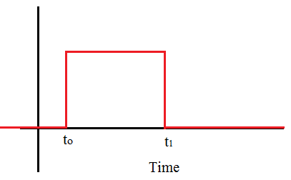
Pulse Waveform
1 --

Slide 10
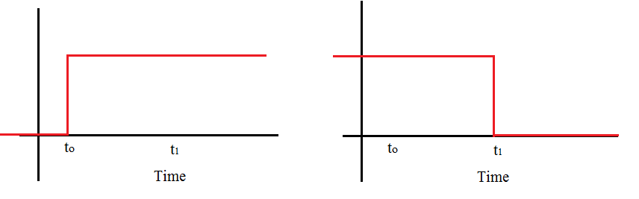
Convolution of Two Unit Step Functions
1 --

Slide 11
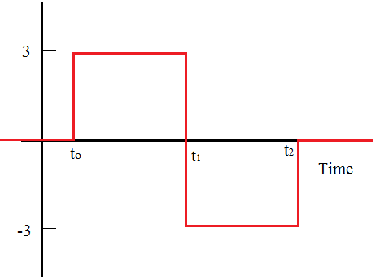
Square Waveform

Slide 12
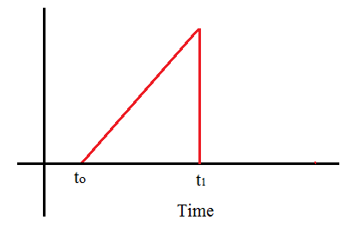
Sawtooth Waveform
This is a ramp function that is discontinued at time t = t₁. To discontinue a ramp function, the function must be multiplied by a second function that doesn’t disturb the ramp when t< t₁, but the result of the multiplication is zero for t ≥ t_{1.}
1 --

Slide 13
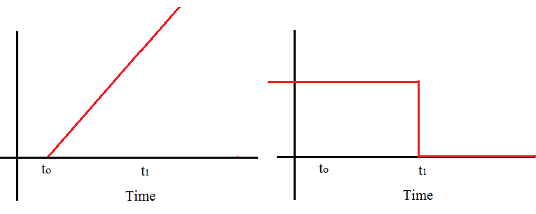
Mathematical Formula
Sawtooth Waveform is formed by multiplying the Ramp Function times the Unit Step Function

Slide 14
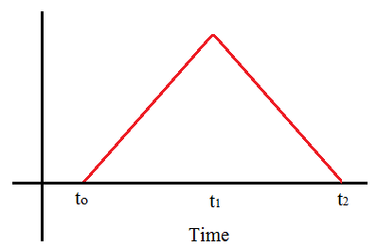
Triangular Waveform
4 --
if t₁ - t_{o} = t₂ - t₁

Slide 15
Composite Waveforms
Any nonsinusoidal function can be expressed as a sum (or composite) of multiple sinusoidal functions.
The sinusoids are related as the frequencies of the sinusoids are integral multiples of some base frequency, known as the fundamental frequency.
The higher frequencies are known as harmonics.
For even and odd harmonics, the multiplier is an even and odd integer, respectively.
The multiplier for 2nd and 3rdharmonics is 2 and 3, respectively.

Slide 16
Infinite Square Wave
An infinite square wave is a weighted sum of a fundamental sinusoid and its odd harmonics.
T is the period of the square waveform.
The fundamental frequency, f_{o} = 1/T.

Slide 17
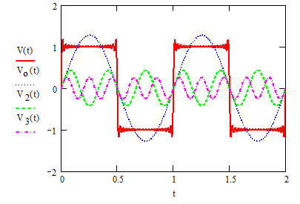
Infinite Square Wave (con’t)
Fundamental
2nd harmonic
3rd harmonic
n = 20
T = 1 s, f_{o} = 1Hz

Slide 18
Summary
Several unit functions were described and their mathematical functions were given.
The convolution of the unit functions can be used to form more complex functions.
Composite waveforms are summations of sinusoidal waves, which is an alternative method to describe complex functions.

